Slide 1
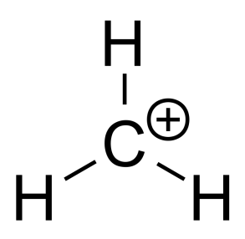

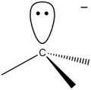


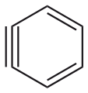
Reaction
Intermediates
Dr. Ajaykumar Gandhi
Assistant Professor
Department of Chemistry
Government College of Arts and Science
Aurangabad

Slide 2
Reaction Intermediates:
a molecular entity that is formed from the reactants (or sometimes preceding intermediates) and reacts further to give the directly observed products of a chemical reaction.
usually short lived and are very seldom isolated. Being short lived, they do not remain in the product mixture.
Some very common intermediates are enlisted below
Carbocation/Carbonium ion
Carbon Free Radical
Carbanion
Benzyne
Carbene
Nitrene
………

Slide 3
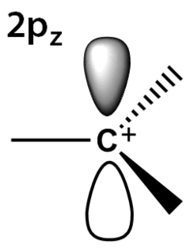
Carbocation/Carbonium ion
A positively-charged carbon atom at centre.
Carbocation is a “sextet” entity i.e. it has only six electrons in its outer valence shell instead of the eight valence electrons that ensures maximum stability (octet rule).
Carbocations are often reactive, seeking to fill the octet of valence electrons as well as regain a neutral charge.
Carbocation have sp² hybridization with trigonal Planar Geometry

Slide 4
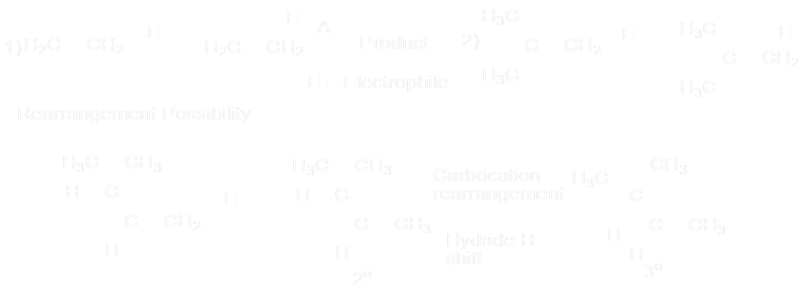
Where do we find Carbocation as an intermediate ?
1. An Electrophilic Addition reactions of Alkene

Slide 5
2. Acid Catalyzed Nucleophilic Substitution reaction

Slide 6
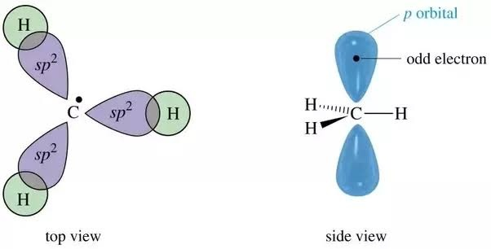
Carbon Free Radical (CFRs)
Carbon atom with an unpaired valence electron.
It has sp² hybridization and is planar in shape.
CFRs are very reactive and tend to dimerize very Quickly.
Like Carbocations, CFRs are also electron deficient and hence stability order for CFRs follow trend same that of carbocations.

Slide 8
Reaction
Intermediates
Continued……

Slide 9
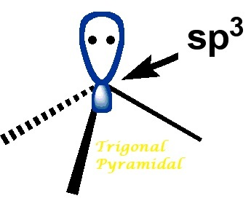

Carbanion
A trivalent entity having Carbon at the centre wit h formal –ve charge.
assume a trigonal pyramidal (${H3C}^{−}$), bent (${PhCH2}^{−}$), or linear geometry (${HC≡C}^{−}$) geometry.
carbanion is the conjugate base of a carbon acid:
Carbanions are typically nucleophilic and basic. The basicity and nucleophilicity of carbanions are determined by the substituents on carbon.
Substituent on Carbanion– the type of inductive effect.
Extent of conjugation – especially that leads to aromaticity.

Slide 10
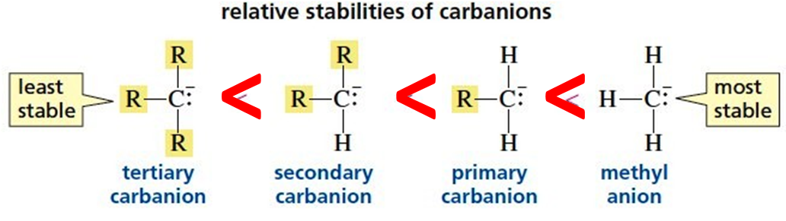
Stability of Carbanion:
1. Inductive Effect:
vinyl > phenyl > cyclopropyl > ethyl > n-propyl > isobutyl > neopentyl > cyclobutyl .
2. Extent of Conjugation:

Slide 11
3. stabilizing field effect of heteroatom (O, N, or S) - carbanion connected to and its multiplicity
FGs in the a position stabilize carbanions in the following order: NO₂ > RCO > COOR > SO₂ > CN $≈$ CONH₂ > Hal ogens > H > R.

Slide 12
4. % S -Character

Slide 13
Generation of Carbanion:

